Slide 1
Regression Models
Ishwar K Sethi

Slide 2
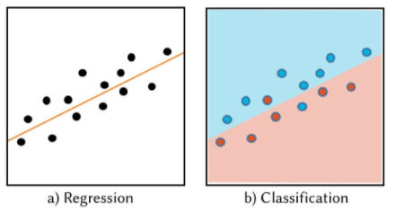
What is Regression?
A return to a former or less developed state – Non-technical definition
A modelling technique wherein the behavior of one or more dependent variables is analyzed with respect to one or more independent variables – Technical definition
Regression involves fitting a curve/surface to multidimensional data that best describes it while classification involves finding a curve/surface that best partitions the data. Both techniques require training set and thus are examples of supervised learning.

Slide 3
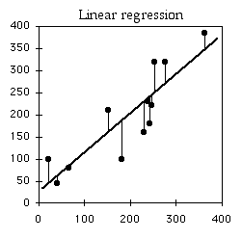
Simple Linear Regression
Two variable case: x – independent (predictor) variable, y – dependent (output variable)
Given {x_{i}, y_{i}}, i= 1, N
Find a₀ and a₁ to fit the following model
ŷ_{i} = a₀ + a₁ x_{i}; i =1, N
By minimizing the prediction error, the following solution is obtained
y
Try to derive the result by taking derivatives of Err w.r.t. a₀ and a₁, set them equal to 0 and solve.
x

Slide 4
Numerical Example
The idea of doing regression here is to see how the sale is affected by changing the number of employees
Number of Employees (x) | Total contract sales (in $10,000's) y
10 | 13
9 | 11
8 | 12
7 | 10
6 | 8
5 | 6
4 | 5
3 | 3
2 | 4
1 | 3
Model
ŷi = 0.79 + 1.218 xi
Residual
The prediction error is called the residual sum of square error. The residual variance is a measure of error fluctuation. The square root of the residual variance is called the standard error of the estimate.
∧
SSE =∑(y_{i} - y_{i} )²

Slide 5
Assessing Model Goodness
Residuals should have…
Randomness
Constant Variance
Normal Distribution
Residual Plot
^
Y - Y
SSR stands for Sum of Squares due to Regression. Measures how far are predicted values from mean of the dependent variable
^
Y
_
_
∧
SST stands for Sum of Squares Total. Similar to variance.
SSR = ∑(Y_{i} - Y)²
SST = ∑(Y_{i} - Y)²
Coefficient of Determination; it measures the proportion of variation in Y explained by (the variation in) X. A value close to 1 is considered good. Why?
R² = SSR/SST

Slide 6
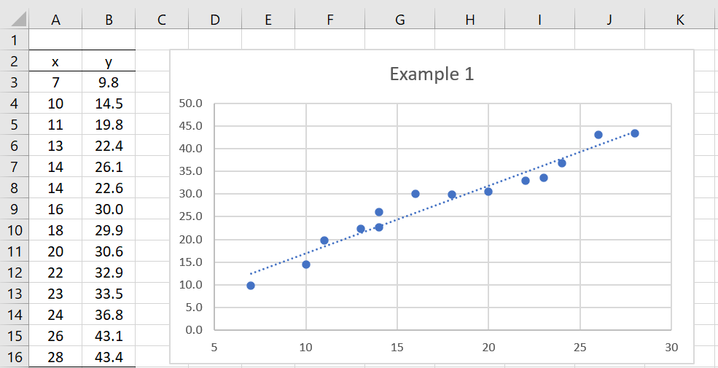
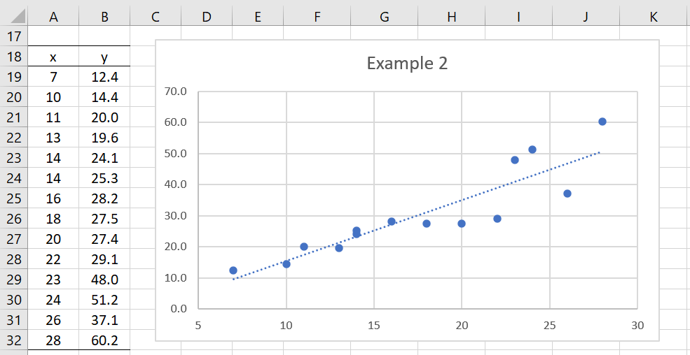
Homoskedasticity vs. Heteroskedasticity
Homoskedasticity: When residuals show
more or less constant variance
Heteroskedasticity: When residuals variance is divergent

Slide 7
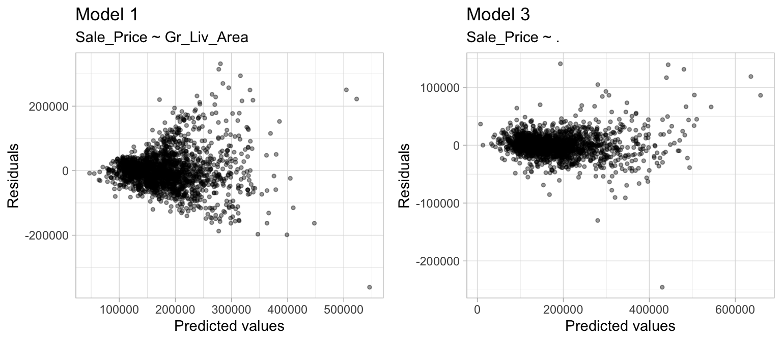
Homoskedasticity vs. Heteroskedasticity
RHS model has additional predictors

Slide 8
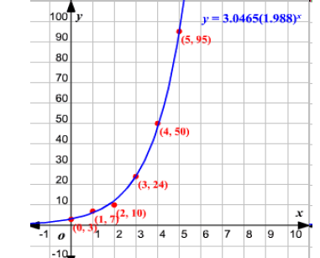
Regression model need not be linear
Y
Quadratic regression model:
Y = b₀ + b₁ X + b₂ X²
X
Logarithmic regression model:
Y = a + b (ln x)
Exponential regression model:
Y = a*b^{x}

Slide 9
Indicator (Dummy) Variables
Dummy, or indicator, variables allow for the inclusion of qualitative variables in the model
For example:
I =
if female
0 if male
Model with Indicator variable:
Y
Y = b₀ + b₁ X + b₂ I
Rewrite the model as:
For I = 0,
For I = 1,
Y = b₀ + b₁ X
Y = (b₀ + b₂) + b₁ X
X

Slide 10
Multiple Linear Regression
When the number of predictor variables is more than one, then the term multiple linear regression is used
In general, the multiple regression equation of y on x₁, x₂, …, x_{k} is given by: y = a₀ + a₁ x₁ + a₂ x₂ + …………………… + a_{k} x_{k}
Representing a's and x's as vectors, and given a set of training examples, we can find a by minimizing
Multiple linear regression is also known as ordinary least squares (OLS) regression.
J(a) =
Such a minimization can be carried out following the LMS rule discussed earlier. For small k, it can be also done using the pseudo-inverse approach

Slide 11
Solution Through Pseudo-inverse Matrix
Error
Applying minimization, we get
= 0
=
Psuedo-inverse

Slide 12
Example: Predicting the Number of Credit Cards
The table on right shows a small part of a credit card company’s database
Build a model to predict the number of credit cards held by a customer
# of CCs Family Size (x1) Income (x2)
1 4 2 14
2 6 2 16
3 6 4 14
4 7 4 17
5 8 5 18
6 7 5 21
7 8 6 17
8 10 6 25
Predicted # of Credit Cards = a0 + a1x1 + a2x2

Slide 13
 |  | 1 | 2 | 14
 |  | 1 | 2 | 16
 |  | 1 | 4 | 14
 |  | 1 | 4 | 17
X | = | 1 | 5 | 18
 |  | 1 | 5 | 21
 |  | 1 | 6 | 17
 |  | 1 | 6 | 25
1 1 1 1 1 1 1 1
X^{t} = 2 2 4 4 5 5 6 6
14 16 14 17 18 21 17 25
8 34 142
(X^{t}X) = 34 162 631
142 631 2616
3.5015 0.0899 -0.2117
(X^{t}X)⁻¹ = 0.0899 0.1044 -0.0301
-0.2117 -0.0301 0.0191
X* =
0.7168 0.2933 0.8966 0.2613 0.1395 -0.4958 0.4411 -1.2529
-0.1221 -0.1822 0.0866 -0.0036 0.0708 -0.0194 0.2052 -0.0352
-0.0041 0.0342 -0.0642 -0.0068 -0.0178 0.0396 -0.0669 0.0861

Slide 14
Y = [4 6 6 7 8 7 8 10]t
0.4817
a = X*Y = 0.6322
0.2158
Ŷ = [4.76 5.19 6.03 6.68 7.52 8.17 7.94 9.67]^{t}
Predicted number of CCs.

Slide 15
Linear Regression Model Recapped
Target output
Actual output
Find the model parameters using n pairs of examples:

Slide 16
Model:
How do we choose model parameters?
By defining a cost function and selecting those parameter values that minimize the cost function
We will perform minimization using gradient descent
Model Parameters:
Cost Function:

Slide 17
We can now write the updating rule. To simplify writing equations, the bias term is absorbed in weight/parameter vector by appending 1 to X vector. We will assume this too for convenience. With this understanding, we have
Updating using all examples is known as batch gradient descent

Slide 18
LMS Rule
Let's do solution updating after every training example. In that case:
Thus, updating rule becomes
This updating rule is also known delta or Widrow-Hoff rule. We saw this rule earlier also.

Slide 19
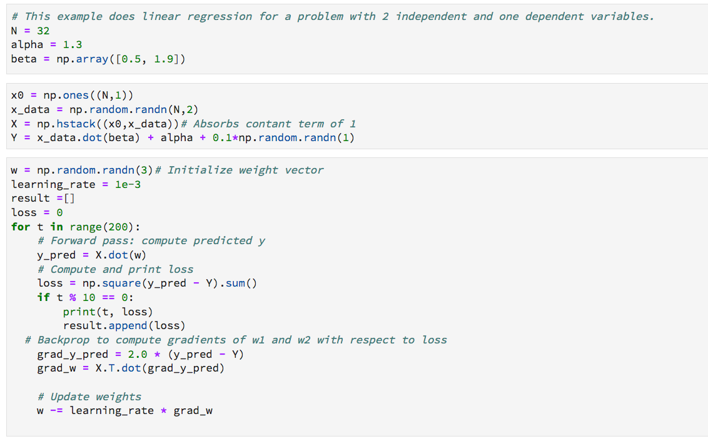
True model parameter Values
Data is being generated from a Gaussian distribution

Slide 20
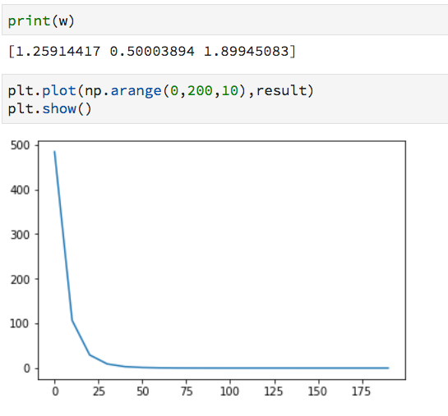
Learned model parameters
Error plot vs. iterations

Slide 21
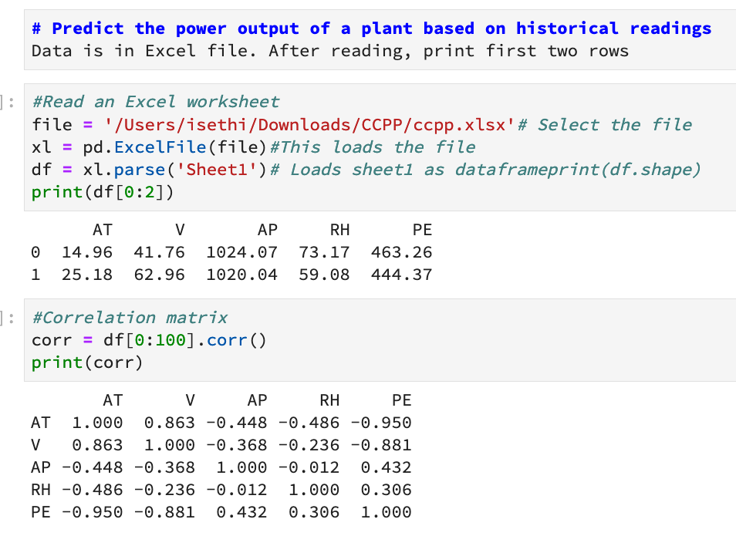
Regression Example Using sklearn

Slide 22
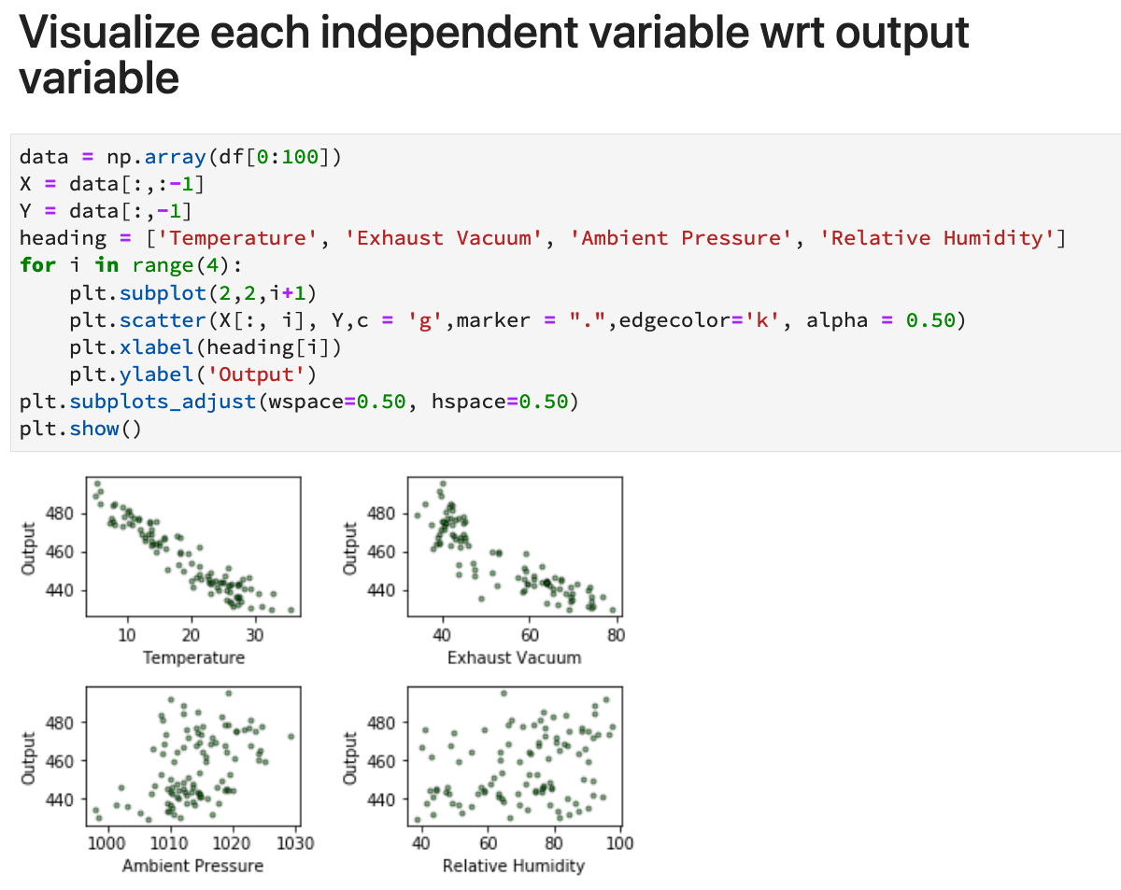

Slide 23
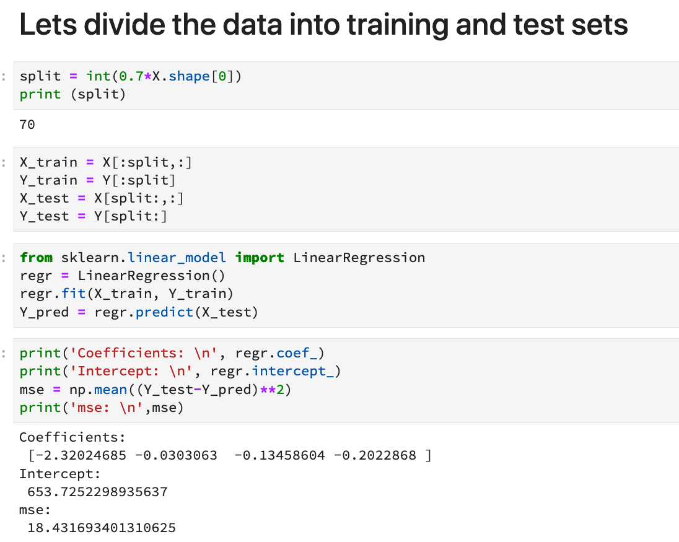

Slide 24
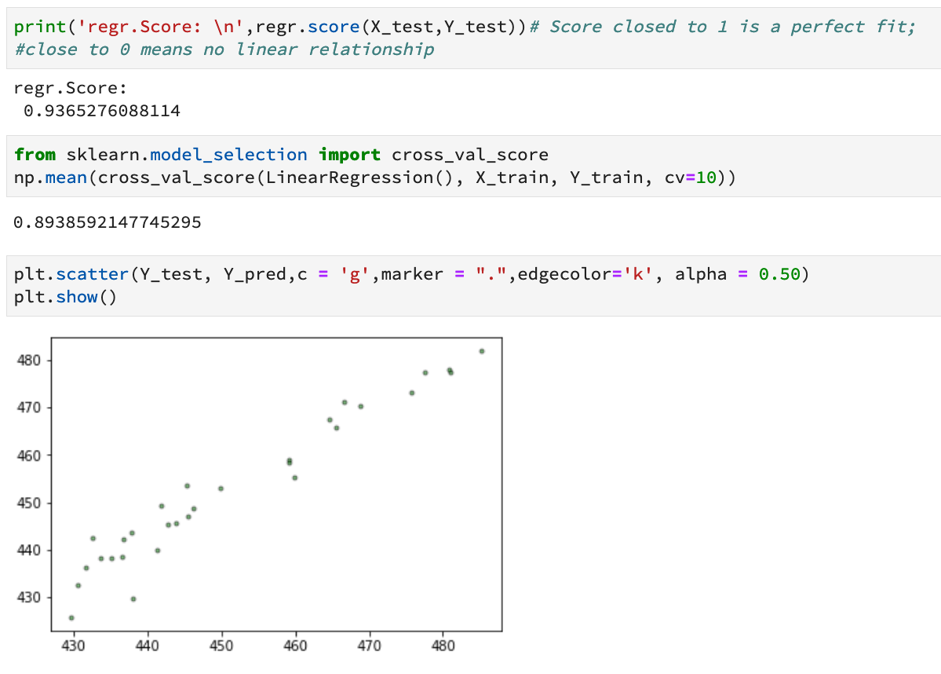
This score close to 1 means a good fit

Slide 25
Subset Selection in Regression
Should we use all features or a subset in our multiple regression model?
Same problem as that of feature selection
Backward and forward stepwise selection methods
PCA
Shrinkage methods

Slide 26
Shrinkage Methods
Basic idea?
Use additional constraints to reduce (shrink) coefficients
Since shrinking is a continuous operator compared to stepwise selection, better regression results with less variability are obtained
Ridge Regression
Minimize least squares subject to:
The LASSO (Least Absolute Shrinkage & Selection Operator)
Minimize least squares subject to:
a_{i} : model parameters
http://statweb.stanford.edu/~tibs/lasso.html

Slide 27
Shrinkage Methods
Also help in avoiding overfitting
The term regularization is also used in many instances
The lasso does better when the response is a function of only a relatively small
number of predictors
In Lasso, the solution is obtained via quadratic programming
A closed form solution exists for ridge regression

Slide 28
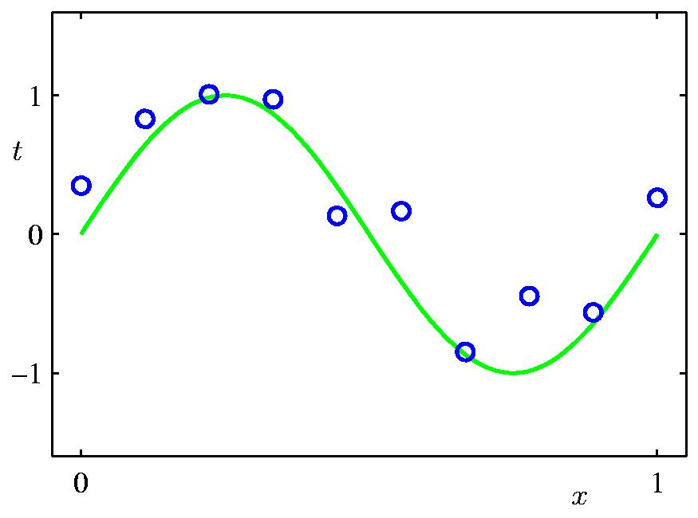
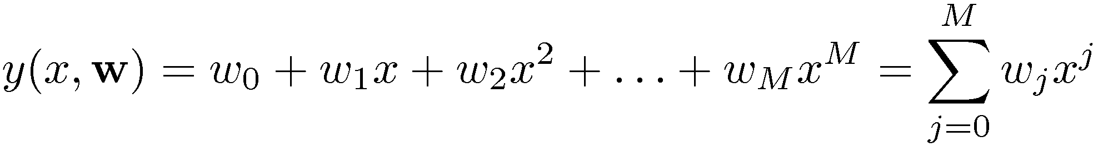
An Example Illustrating Use of a Shrinkage Method
We are given 10 (x,y) pair of points to fit a regression model
Model

Slide 29
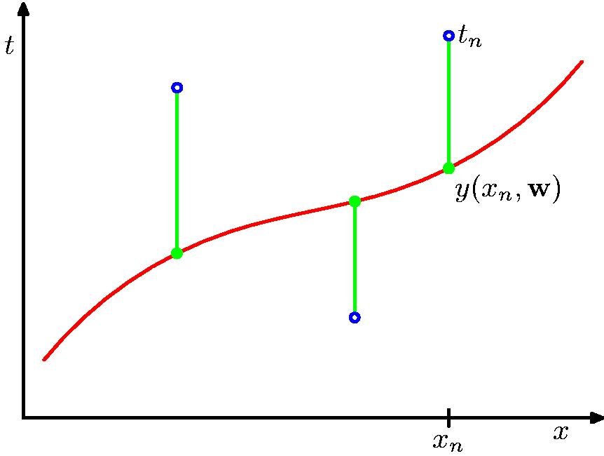
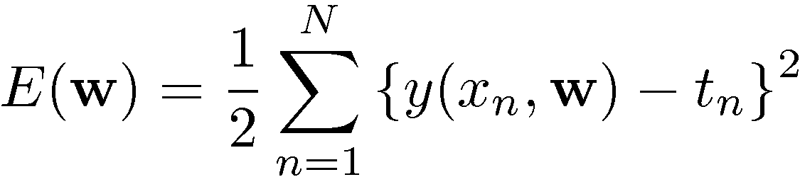
Sum-of-Squares Error Function

Slide 30
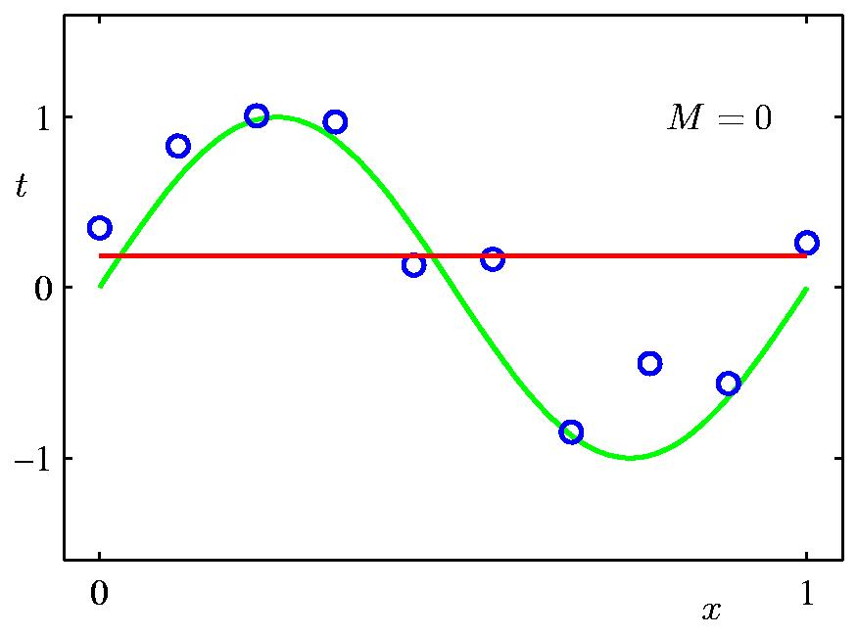
0th Order Polynomial Fit

Slide 31
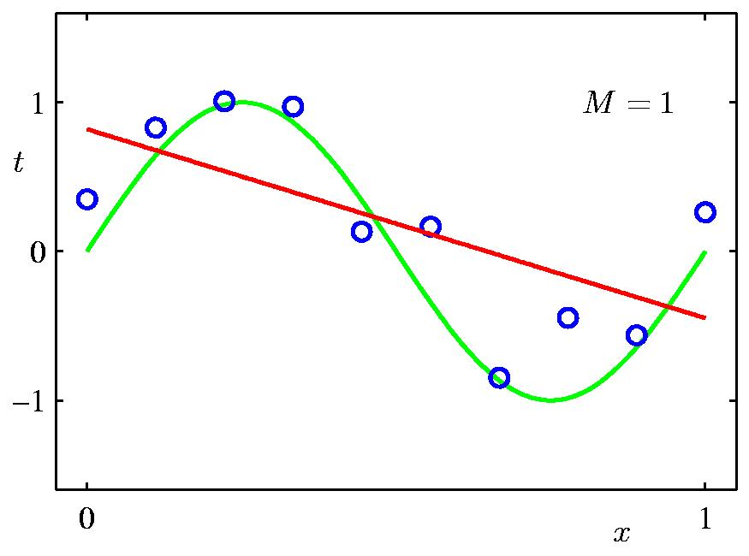
1st Order Polynomial Fit

Slide 32
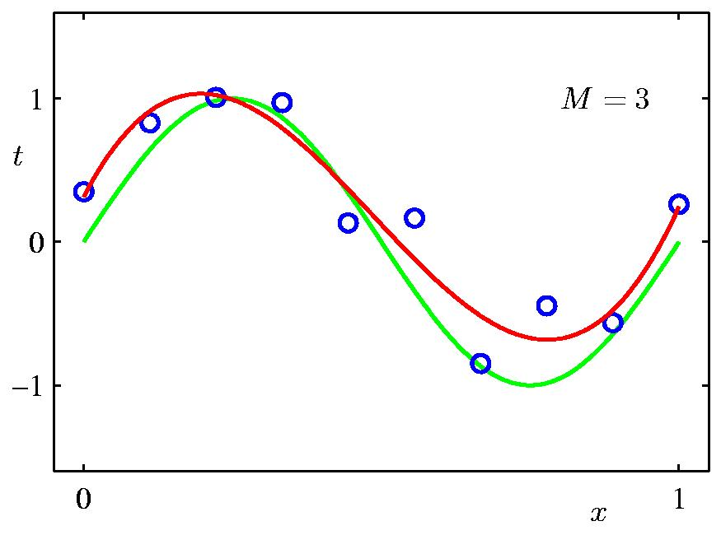
3rd Order Polynomial Fit
Looks like a good fit

Slide 33
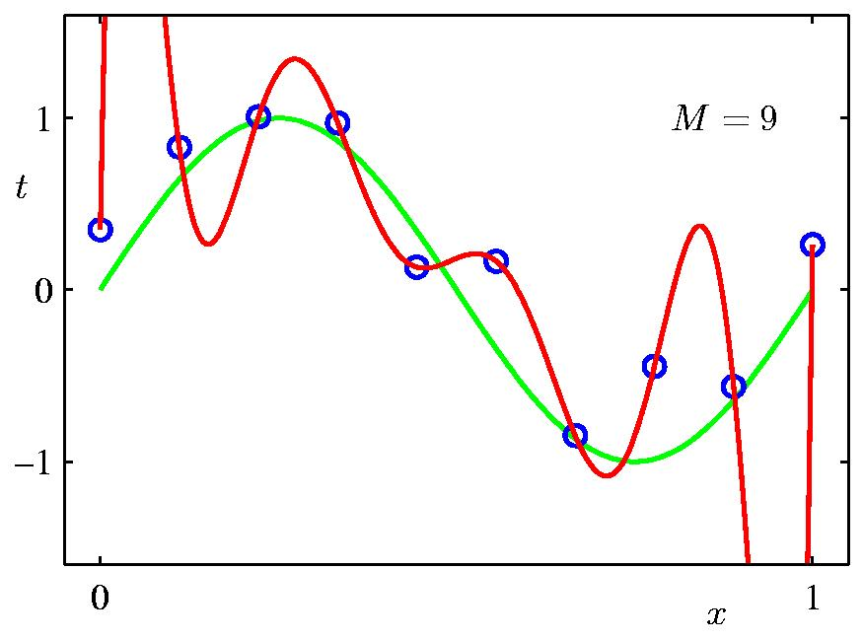
9th Order Polynomial Fit
Zero error fit. Is this the best model for this problem?

Slide 34
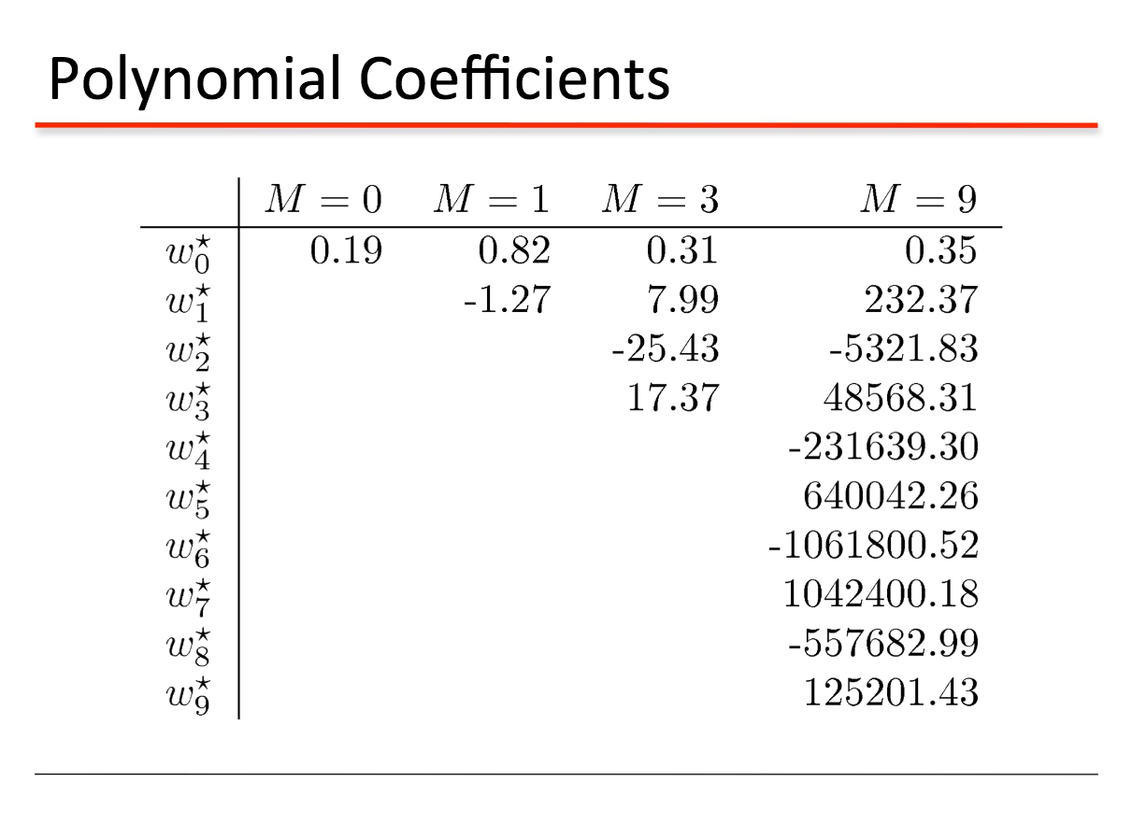
These are the values of the fitted coefficients. Note extremely high values for the 9-th order model

Slide 35
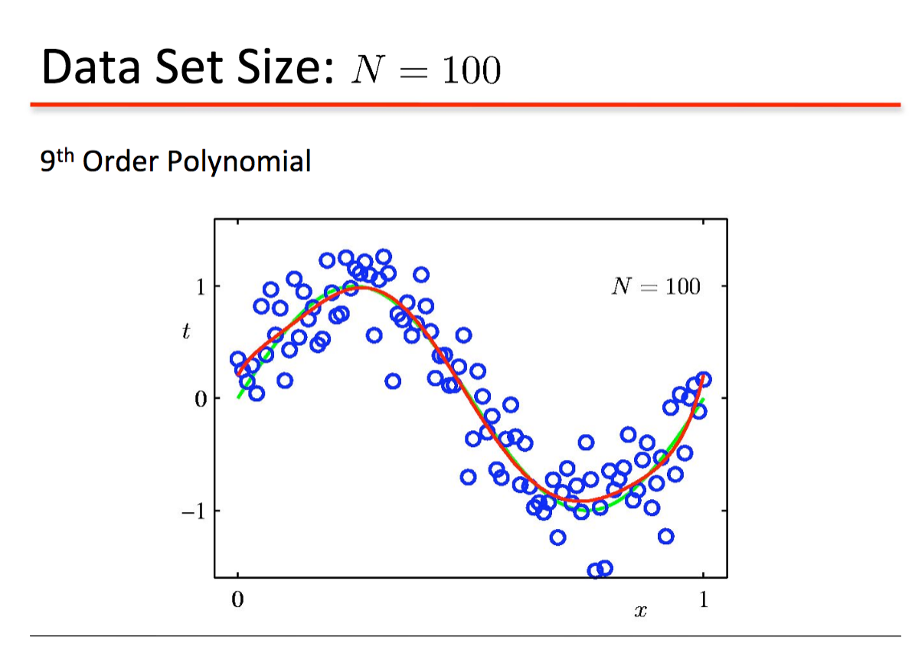
Overfitting reduces with 100 pairs of (x,y) values

Slide 36
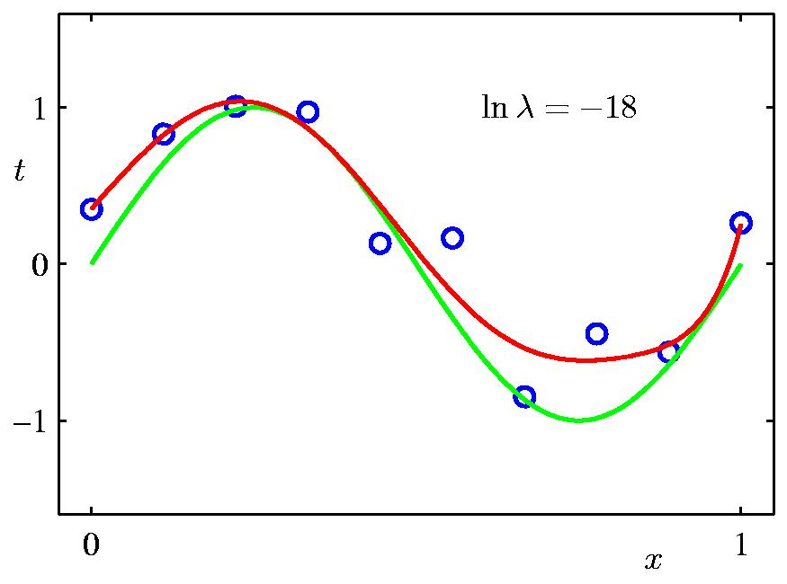
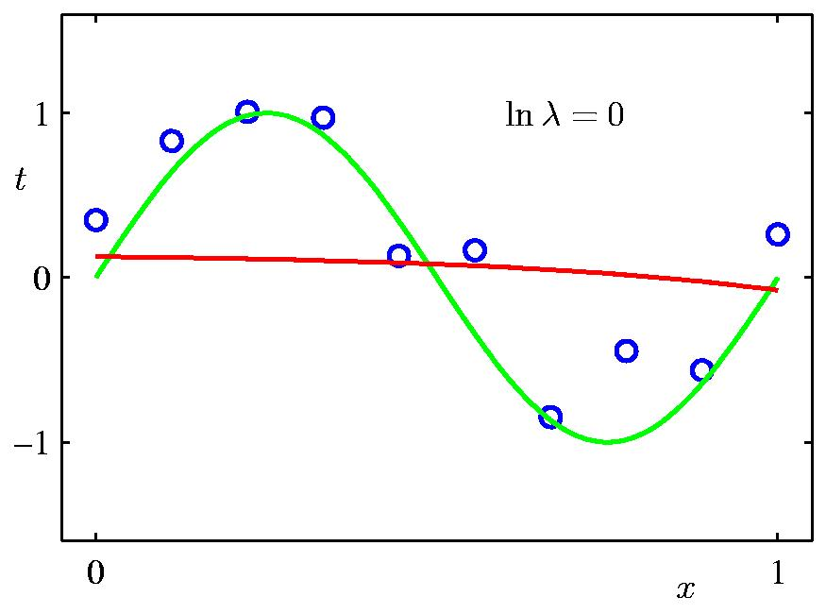
9-th order model fitting with regularization/ridge regression for two values of lambda
No regularization
Although we are using a 9-th model, the result is similar to the 3-rd order model without shrinkage

Slide 37
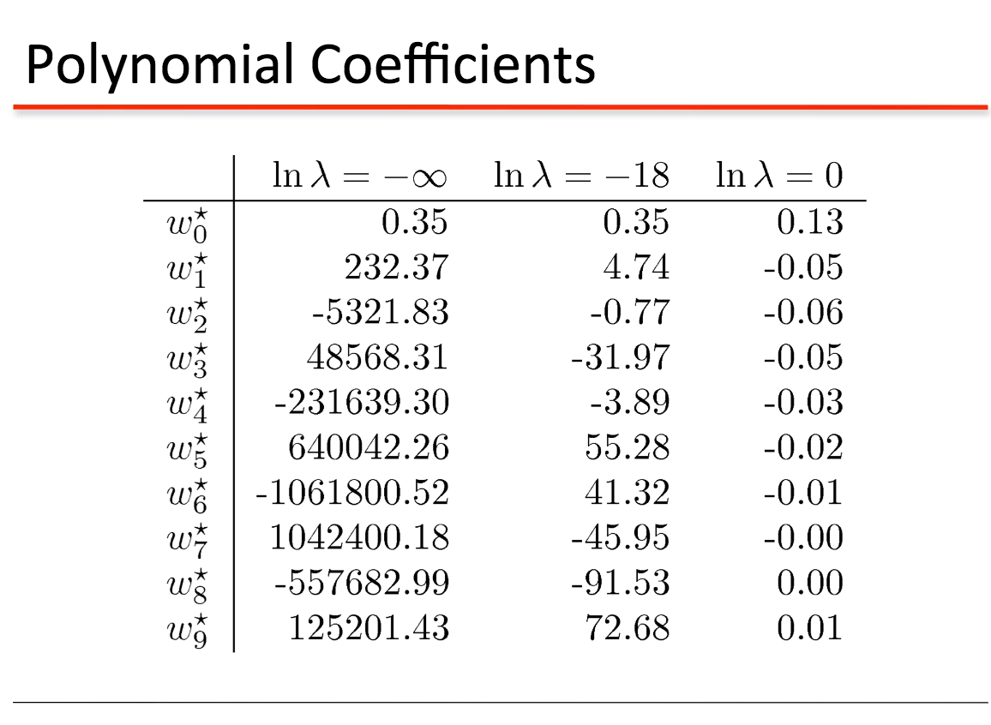
Shrinkage effect on coefficients

Slide 38
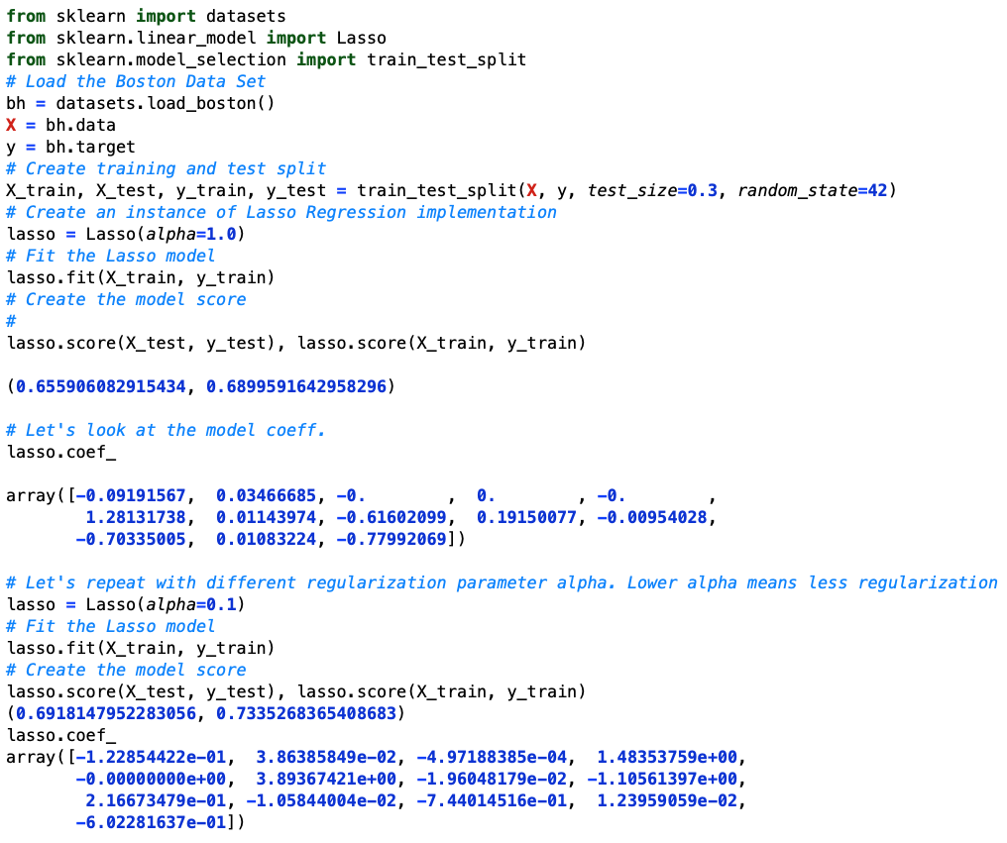
Lasso (Least Absolute Shrinkage & Selection Operator Demo

Slide 39
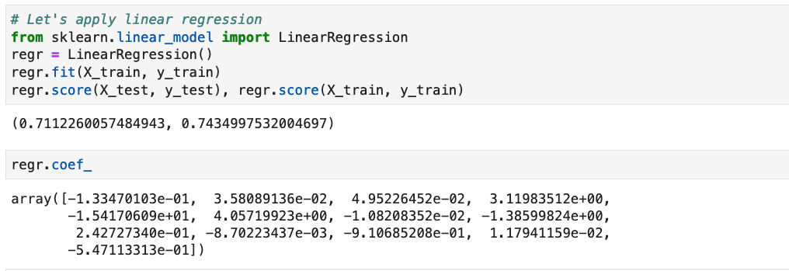
Results using Linear Regression

Slide 40
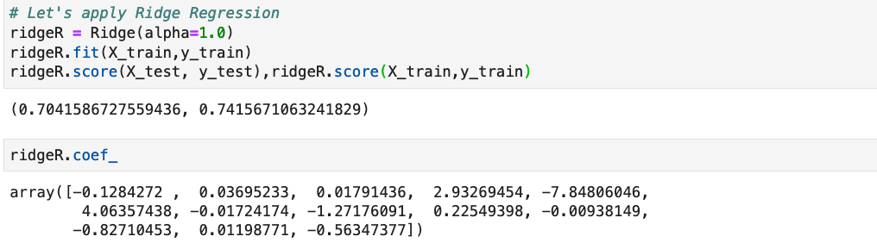
Ridge Regression Results

Slide 41
Logistic Regression
Let’s consider the following model used in linear regression. But in this case the dependent/outcome variable (y) is a discrete variable (good/bad customer)
y = a₀ + a₁ x₁ + a₂ x₂ + …………………… + a_{k} x_{k}
Let’s look at the following expression
The quantity p will always lie in the range 0-1 and thus can be interpreted as the probability of outcome y being good or bad.
Logistic regression is a classification model

Slide 42
Logistic Regression
By simple rewriting, we get:
log(p/(1-p)) = a₀ + a₁x₁ + a₂x₂ +··· + a_{k}x_{k}
This ratio is called log odds
The parameters of the logistic model are determined using the likelihood maximization-based cost function optimized via gradient search

Slide 43
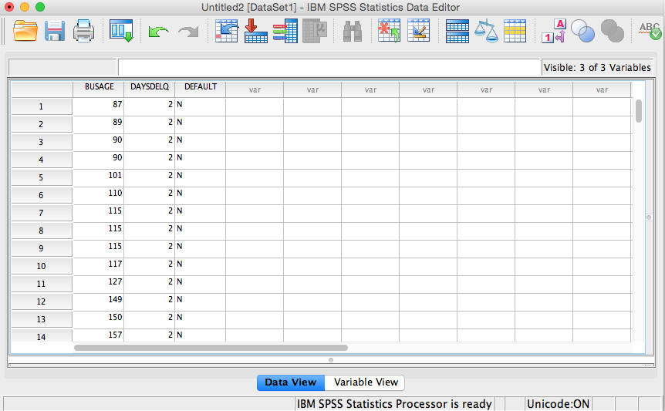
Credit Default Example
Two attributes. BusAge in months and number of days delinquent. Target variable whether defaulted or not

Slide 44
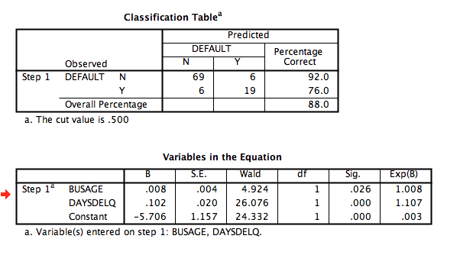
Credit Scoring Example

Slide 45
Using the Model
What is the probability of a business defaulting given that business has been with the bank for 26 months and is delinquent for 58 days?
BUSAGE: 0.008; DAYSDELQ: 0.102; Intercept: -5.076
e^{0.008*26+0.102*58-5.706}/(1+e^{0.008*26+0.102*58-5.706})
Plug the model parameters to calculate p
0.603

Slide 46
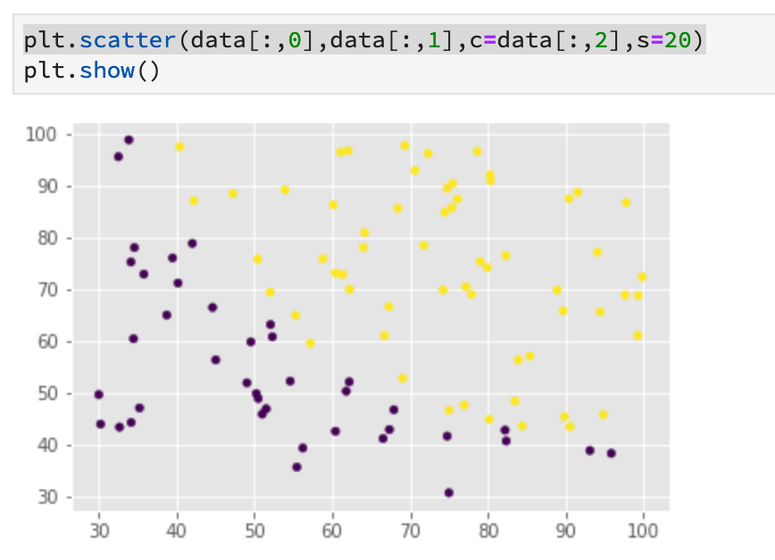
Python Example using 2-D Data

Slide 47
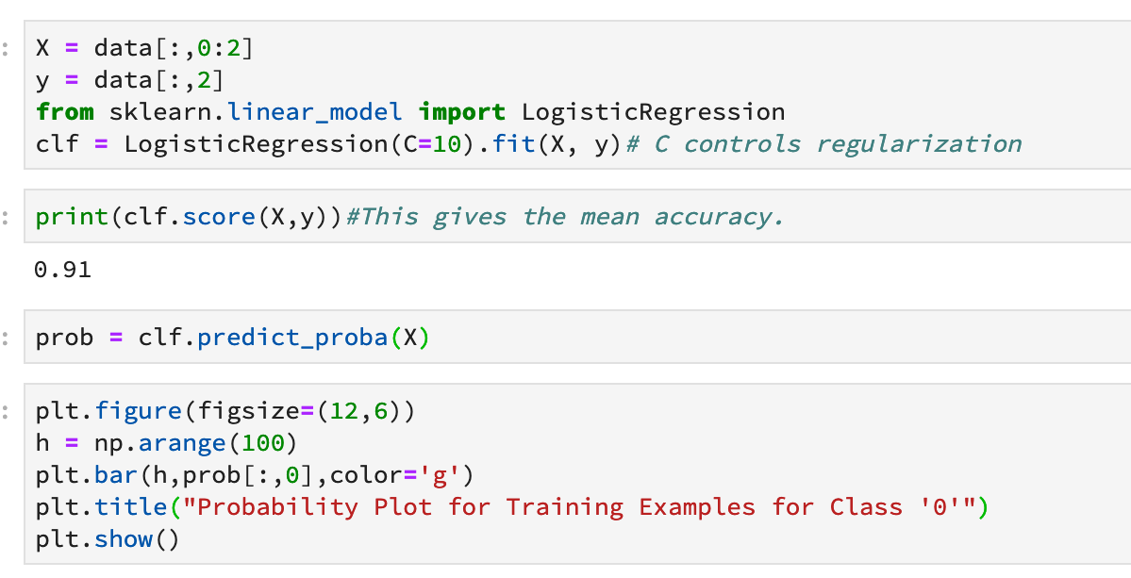

Slide 48
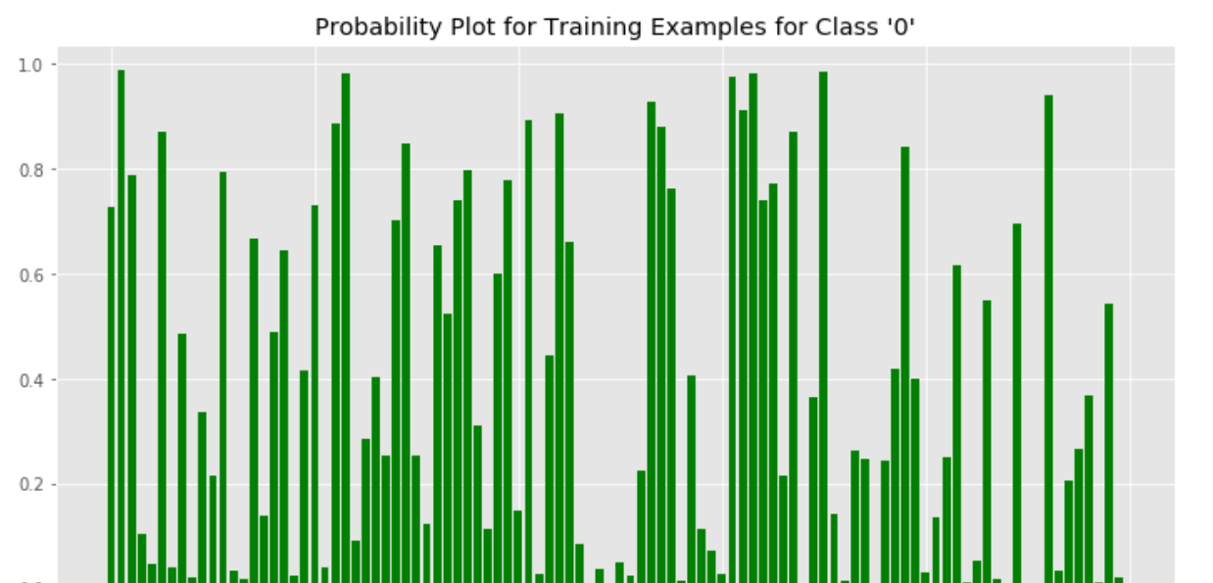
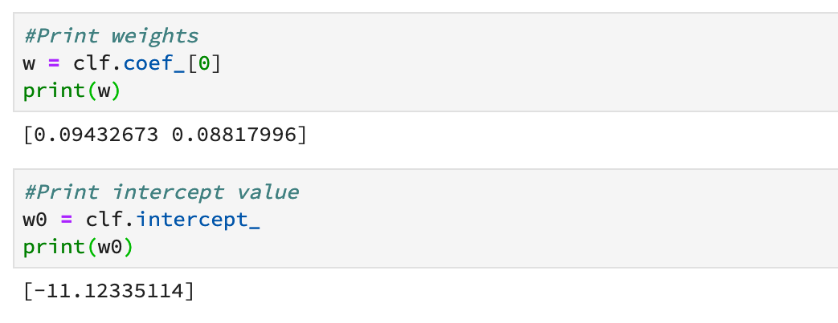

Slide 49
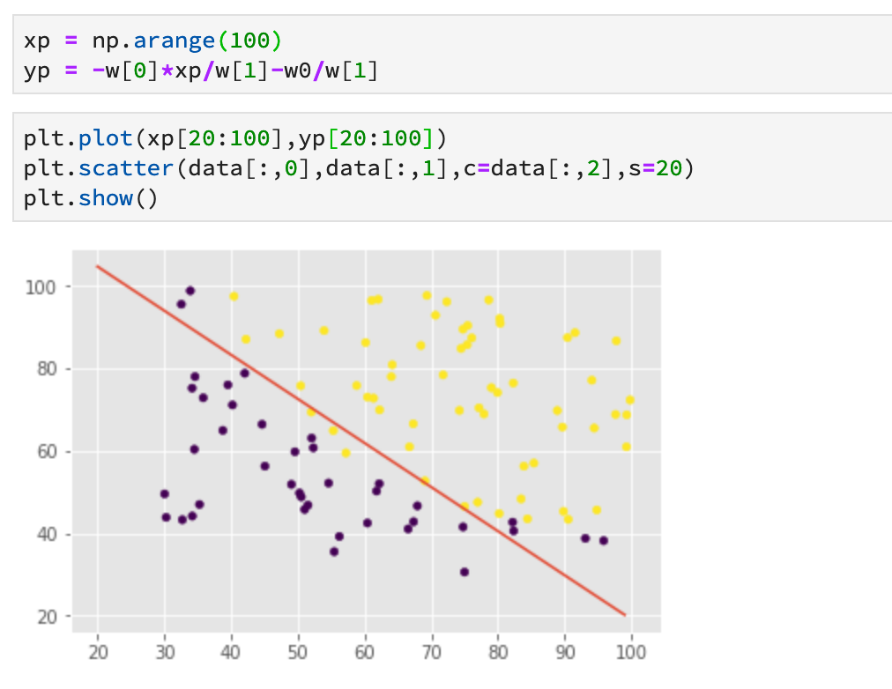
Logistic regression is identical to a single neuron classifier with sigmoidal nonlinearity

Slide 50
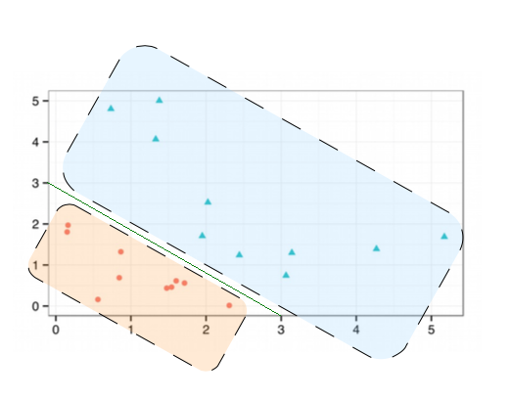
Example
What will be the prediction, 0 or 1, of the logistic regression model for an input [2 5]^{T}?
How does the decision boundary look like in x₁-x₂ space?
Coefficients in a logistic regression model

Slide 51
Non-linear Regression
How can we perform nonlinear regression?
We can use some of the non-parametric methods that were used for classification
KNN Regression
Find k neighbors and combine their dependent variable values
Regression Tree
Discussed next
Feedforward Neural Network
Example shown later

Slide 52
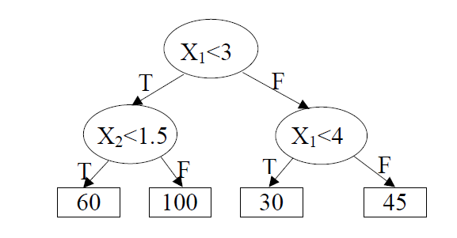
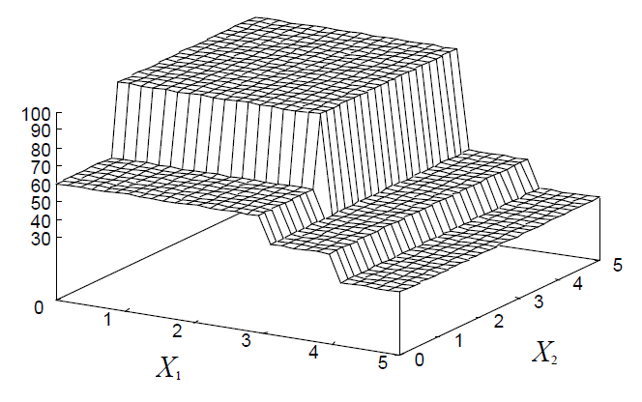
Regression Tree
Regression tree modelling uses MSE criterion to determine splits
This tree roughly corresponds to the following regression surface (assuming that there were only the predictor variables X1 and X2 ) :

Slide 53
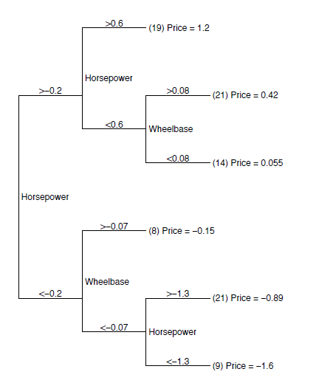
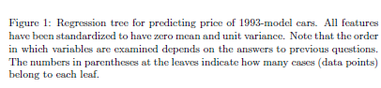
Regression Tree Example

Slide 54
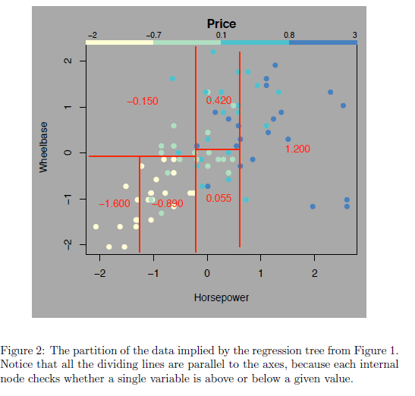
Regression Tree Example

Slide 55
Regression Tree Example using Sklearn
import numpy as np
from sklearn.tree import DecisionTreeRegressor
import matplotlib.pyplot as plt
# We will use a noisy sin function for data generation
rng = np.random.RandomState(1)
X = np.linspace(0,5,100).reshape(-1,1)
#X = np.sort(5 * rng.rand(100, 1), axis=0)
y = np.sin(X).ravel()
y[::5] += 0.5*(0.5-rng.rand(20))
# Let's model data with a regression tree
# We will produce two trees with different depths
regr_1 = DecisionTreeRegressor(max_depth=2)
regr_2 = DecisionTreeRegressor(max_depth=4)
regr_1.fit(X, y)
regr_2.fit(X, y)

Slide 56
Regression Tree Example Contd.
# Predict
X_test = np.arange(0.0, 5.0, 0.05)[:, np.newaxis]
y_1 = regr_1.predict(X_test)
y_2 = regr_2.predict(X_test)
# Let's plot results
plt.figure()
plt.scatter(X, y, s=20, edgecolor="black", c="darkorange", label="data")
plt.plot(X_test, y_1, color="cornflowerblue", label="max_depth=2", linewidth=2)
plt.plot(X_test, y_2, color="red", label="max_depth=4", linewidth=2)
plt.xlabel("data")
plt.ylabel("target")
plt.title("Decision Tree Regression")
plt.legend()
plt.show()

Slide 57
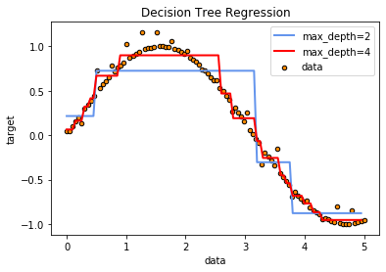
Regression Tree Plot
Shows how to sin function is approximated by a combination of step functions

Slide 58
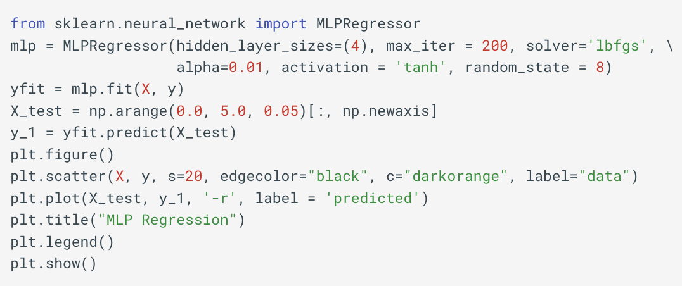
Regression using MLP Network
In place of output being class labels, the output in this case is a continuous number.
The following code shows MLP-based regression using the same data from the regression tree example

Slide 59
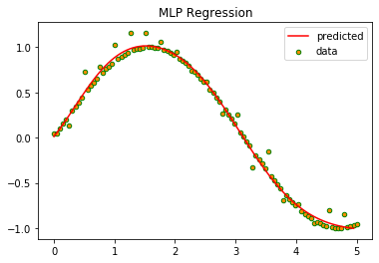
MLP Regression Result
The MLP has accurately learned to predict the output.

Slide 60
Regression Summary
A type of supervised learning for quantitative dependent variables
Numerous applications
Multicollinearity (situation when predictors are highly correlated) requires additional attention. Check the following post for details.
https://iksinc.online/2019/01/07/how-to-perform-regression-with-more-predictors-than-observations/

